Slide 1
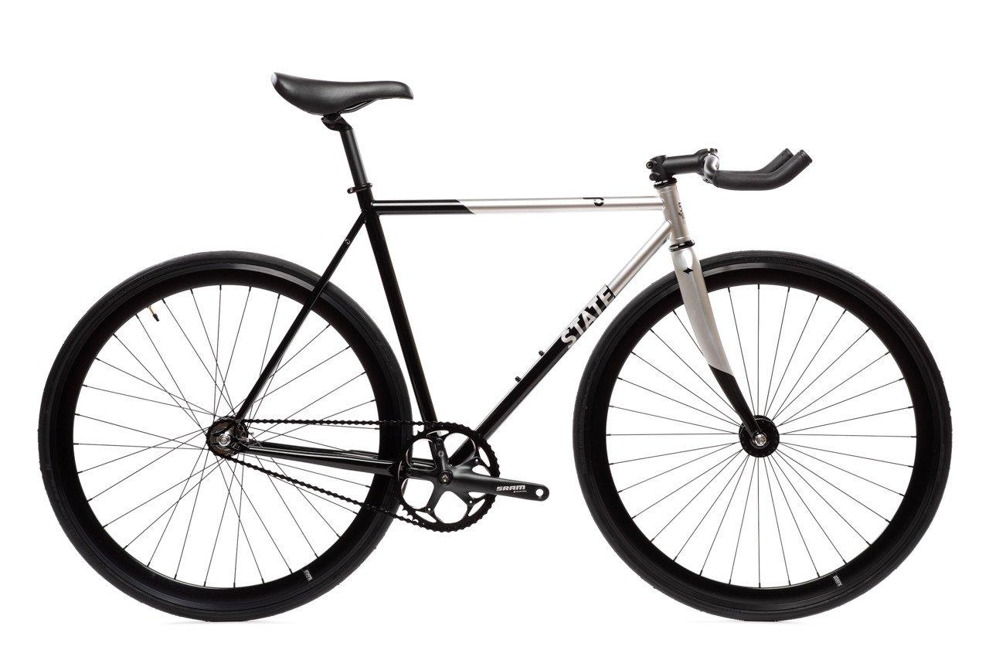
iP l
In-campus smart bicycle-sharing system
Kedar Anavardekar
Shinjan Mitra
Sapan Tanted

Slide 2



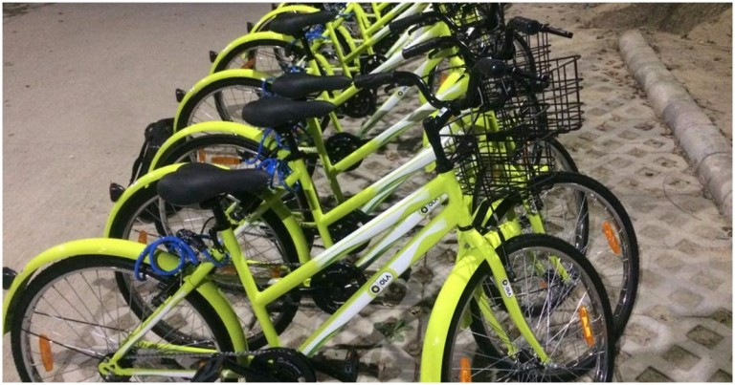

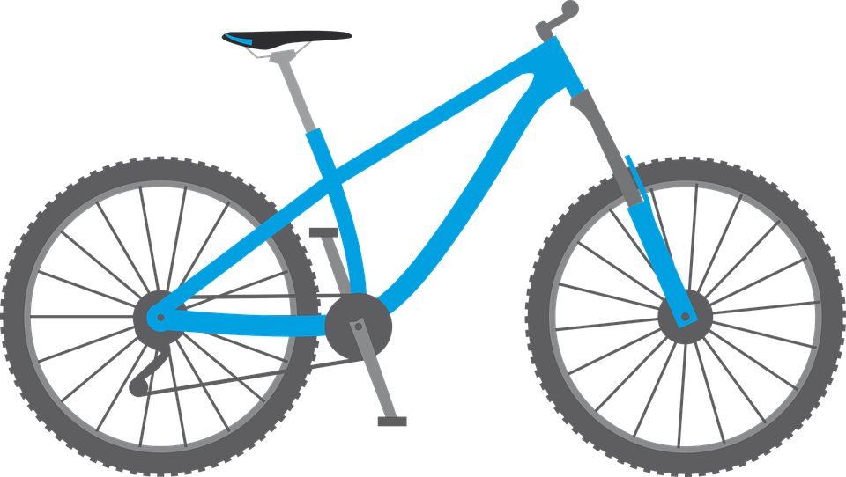



Problems
Bicycles are the key to sustainable transport in the future and even now.
None of the IITs have fully functional bicycle sharing facility
Existing Solutions
Ola Pedal (IIT Kanpur pilot)
Fixed drop-off points
Immutable lock codes
Ofo China

Slide 3

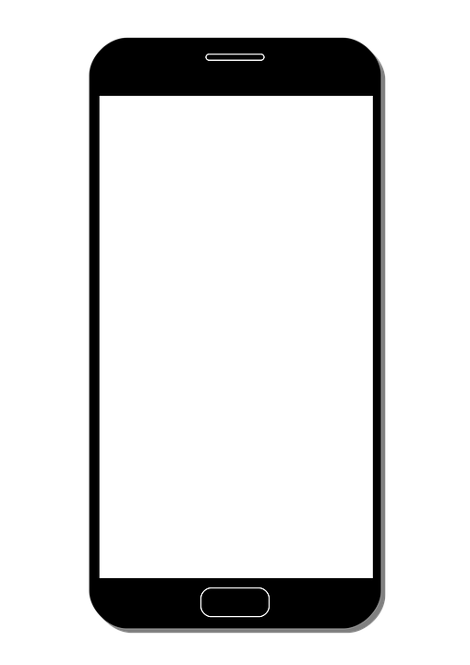




Our Solution
Cloud-connected smart plug-and-play device with companion smartphone app.
Can be fitted on to pool of commodity cycles.
Need to retrofit iPool module on lock.
Find an iPool bicycle nearby, issue using the app and take off!
What will be the impact?
Prompt availability of transportation. Get it when you need it!
Economic and eco-friendlier than other public or private transport.
iPool

Slide 4






Hardware components required
Bluetooth device
12v LiPo battery + battery indicator
Low power microcontroller
rack and pinion mechanism + motor
3D printed case for lock (prototype)
Button, led, buzzer, etc….

Slide 5



Challenges and Timeline
Challenges & Timeline
Implementation
Tamper Proof Lock
Location Tracking
Protecting User Privacy
Timeline
Development of smart lock – March end
App Development – March end
Backend development – March mid
Testing - April

Slide 6
Thank You

